Slide 1
International Atomic Energy Agency Learning programme: Radon gas
Module 5:
Radon Measurement for
the Representative Indoor Radon Survey

Slide 2
Content
International requirements
Requirements of the representative indoor radon survey
Detector types
Seasonal variation
Measurement duration
Detector placement in homes
Detector storage, packaging, and transport
Quality assurance
Summary of learning points
Additional reading

Slide 3
Requirements for representative indoor radon survey
IAEA Specific Safety Guide (SSG-32) recommends:
Para 3.32. For radon measurements in dwellings and other buildings with high occupancy factors for the public, the national authority should specify:
The minimum measurement period;
Quality standards for radon detectors;
The measurement protocols to be applied;
Whether measurements should be limited to certain seasons;
Whether or not seasonal correction factors should be applied to the results;
Quality standards for reporting results to owners of the dwellings and other buildings with high occupancy factors for the public;
The advice that should be offered to owners of dwellings and other buildings with high occupancy factors for the public that have concentrations of radon in excess of the reference level.
*This module will provide more detail on (a) to (e)
Notes:
The IAEA Safety Guide SSG-32 lists aspects of radon measurements which should be established as standards by the national authority.
Each of these are relevant to the implementation of a measurement programme to support a representative radon survey.
This module will provide more detail on (a) to (e) and other aspects of radon measurement, in particular, the requirement for quality assurance.

Slide 4
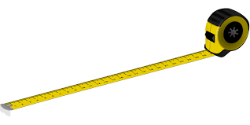
Measurement protocol overview
What to measure – radon gas
Detector types
Where to measure and detector position
Homes
Representative
Manufacturers recommendations
Exposed to environment of the room
Duration of measurement
Fluctuations
Period of measurement
Detector handling, packaging, and transport
Quality assurance and quality control
Notes:
When commencing a representative radon survey the responsible national authority should decide on the suite of protocols and processes that will make up the standard operating procedure of the survey.
Establishing this at the beginning means that variability due to different methods and processes can be minimised, measurements taken now can be confidently compared with future measurements, measurements made by different service providers using the same standard operating procedures can be compared with confidence.
The standard procedures should go beyond just measurement protocols and take account that factors outside the lab, such as handling, packaging, and placement can affect the measurements.
Quality assurance and quality checks are an essential part of the standard procedures.
The procedures should also define the policy of the national authority regarding data reporting to the householder. The engagement of the householder is a critical element of the success of a measurement programme.
The elements of the protocol are further detailed in the following slides.
What to measure: Although radon decay products, primarily polonium (²¹⁸Po and ²¹⁴Po), are responsible for most of the radiation dose delivered by radon (²²²Rn), radon gas concentration is generally considered a good surrogate for the radon decay product concentration.

Slide 5
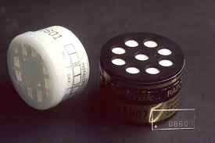
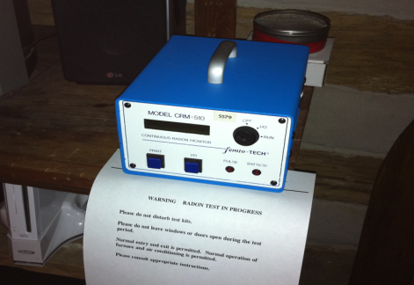
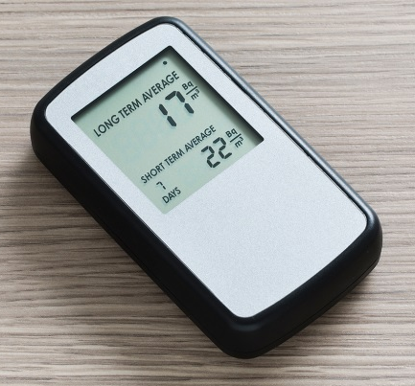
Detector Types
Passive and Active
Measurement types –
Integrated
Continuous
Spot
Exposure duration –
Short term
Long term
Sensitivity
Notes:
There is a range of detector types commercially available, each suitable in different situations, and classed in a number of ways.
There are passive detectors which rely on the natural diffusion of radon gas into the detector, and active detectors in which they require a pump drawing in a known amount of air over the sampling period.
Passive detectors provide a time integrated measurement – i.e., a single measurement that represents the radon concentration detected over the entire sampling period.
Active detectors can provide continuous measurements giving information on the time dependence of radon concentration, and spot measurements over specified time intervals. These methods are usually for shorter term measurements.
Most detectors are designed to detect alpha particles in air, while some are based on detection of gamma emissions and some beta particles
Different detector types are more suitable for long- or short-term measurements.
Some detectors are sensitive to the influence of other alpha emitters (such as thoron) which may be emitted from building materials in the home.
Decision on which detector type is driven by technical requirements but in many cases is largely determined by practical issues of cost and convenience. The survey scale and methodology (i.e. whether it is to be undertaken largely through the postal service) will both be key drivers for the decision, as cost will be a limiting factor in large scale studies and handling will be a key consideration in a postal-based system.

Slide 6
Detector Types (cont’d)
DETECTOR TYPE | PASSIVE / ACTIVE | TYPICAL SAMPLING PERIOD | COST
Alpha-Track Detector | Passive | 1 - 12 months | low
Activated Charcoal Detector | Passive | 1 – 7 days | low
Electret Ion Chamber | Passive | 2 days - 1 year | medium
Continuous Radon Monitor | Active | 1 hour – 1 year | high
WHO (2009), Handbook on Indoor Radon
Standard protocol for a representative survey
Notes:
In order to carry out a representative survey in a large number of dwellings, a technique is needed with the following main requirements:
sampling periods of 3 to 12 months,
low cost, and
low impact (i.e. small size of the measuring device).
This table presents the most popular and widely-used radon detectors and highlights their suitability in terms of these requirements. Further details on the four major types of detectors (alpha –track detector, activated charcoal detector, electret ion chamber and continuous radon monitor) and their advantages and disadvantages, are provided in the WHO Handbook on Indoor Radon (2009).

Slide 7
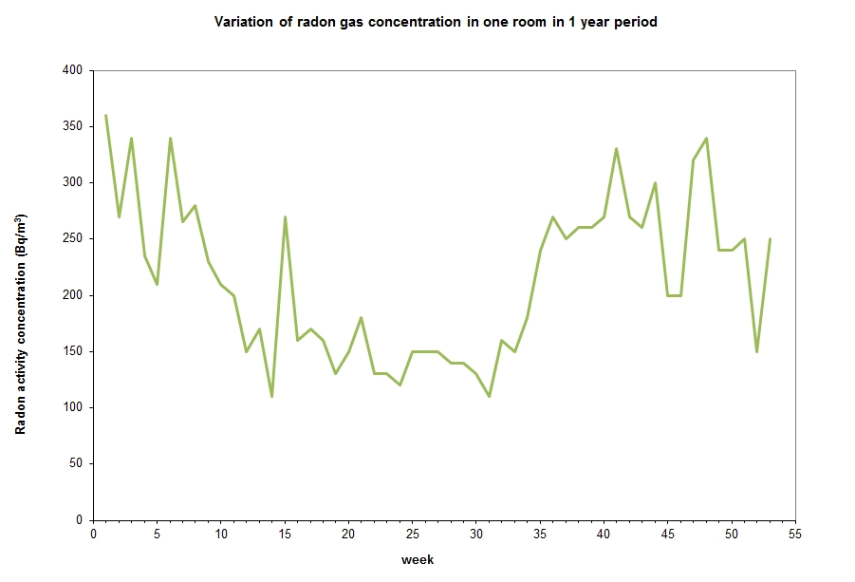
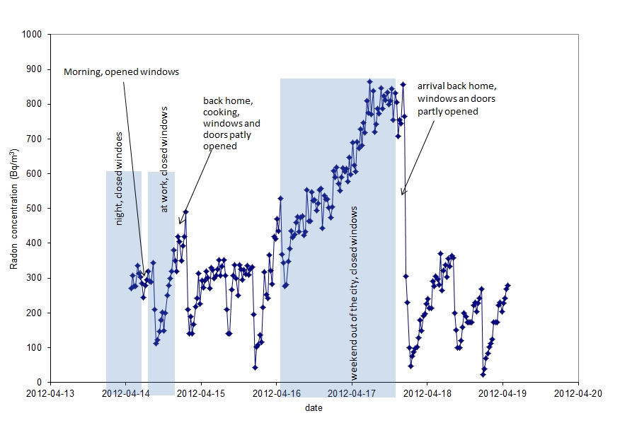
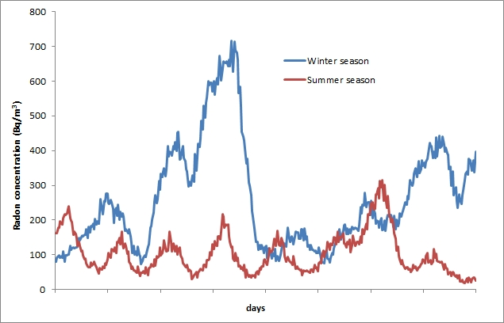
Fluctuations in Indoor Radon
(A)
(C)
(B)
Variation of radon concentration over
(A) one year,
(B) seasonally, and
(C) daily
Source: BfS Germany
Notes:
It is widely recorded that radon concentration varies over time – year to year, with different seasons, day to day and within the day. This variation needs to be taken into account.
These graphs show three temporal trends in radon concentrations – (A) over a year, (B) in summer compared to winter and (C) over the course of a day.
(A) Typically higher radon concentrations are observed in homes in the heating season (winter) but you can see that the variations over the course of the year are not smooth – there are significant peaks and troughs/valleys in the data even within one season.
(B) Similarly, the comparison of winter and summer data show higher values in winter (heating season, less ventilation). Again, there are significant variations within the season. This figure shows summer values increasing weekly, probably due to a different pattern of occupier behaviour over the weekend.
(C) The daily fluctuations show how the radon concentrations rise when the house is not occupied and change with the opening and closing of windows.

Slide 8
Seasonal Variation and Correction Factors
Radon concentrations in homes vary over short and long time scales
This represents a collective variation of radon – integrating fluctuations in soil gas emanations, and fluctuations in the relative entry rates and exit rates of radon gas in the home.
Measurement protocol should be established to minimise the impacts of these variations on the representativeness of the radon survey data (annual average)
Annual averages can be determined by short duration measurements (minimum 2 months) provided seasonal corrections are applied
Seasonal correction factors should be derived nationally or locally
It is not recommended to use seasonal correction factors derived in other countries as they may not be representative
Standard protocol for the representative survey
Notes:
The previous slide shows that radon concentrations in homes can have great variations over time.
This variability needs to be taken into account in the measurement protocol for the representative survey.
It has impact on:
(a) the type of detectors to be used
(b) the duration of the measurement
(c) the timing of the measurement (i.e., whether in a particular season or any season),
(d) the requirement or otherwise for local studies on radon concentration variability, and
(e) the corrections to be applied in the data analysis stage.
In principle, 1-year measurements provide the best means of determining an annual average. However, shorter measurements (at least 3 months) can be used if appropriate corrections are made considering variations for such shorter periods.
Seasonal correction factors should be determined nationally or if necessary regionally.
It is not recommended to use seasonal correction factors derived in other countries due to different occupancy patterns, building construction types, heating arrangements, or contribution of different radon sources.
The standard protocol for the representative survey should address the issue of variability and seasonal correction.

Slide 9
Measurement duration
Balancing speed of access to data, reliability of measurement, cost of survey, and detector losses
Annual average best estimated with a measurement period of one year
One year measurement = two consecutive 6-month measurement = 4 consecutive 3-month measurements
Shorter term measurements are not recommended (shorter than 2 month)
Any 3-month period versus a particular 3-month period
Notes:
“Short-term” measurements refer to measurements that average radon concentrations over days or weeks, while “long-term” measurements generally cover a season or more (several months to one year).
In order to measure the long-term (annual) average radon concentration in a dwelling, a long-term measurement should be carried out.
As previously mentioned, long term radon measurements are preferred because temporal variations of a factor of two or more commonly occur in repeated short-term measurements.
Ideally, an annual average will be determined by measurement of 1 year in duration. This can also be achieved by two consecutive six-month measurements, or four consecutive three-month measurements.
Splitting the annual measurement into shorter periods will minimise the impact of ageing and fading effects of the detector and track-counting system which can occur in long-term measurements using alpha track detectors. For 12-month measurements this should be evaluated and taken into account.
However, splitting the annual measurement will increase the costs due to a larger number of detectors being required and more handling and analysis costs. Detector losses from shorter term measurements will be less than for long-term measurements.
If the survey is to be based on 3-month measurements: the national authority should decide if the measurements can be taken in any 3-month period, or in a particular 3-month period.
If any 3-month period is specified in the standard protocol for the survey, then a seasonal correction factor must be applied.
If a particular 3-month period is specified, then it is recommended that this be the heating (or cold) season, so that a worst case scenario is evaluated.

Slide 10
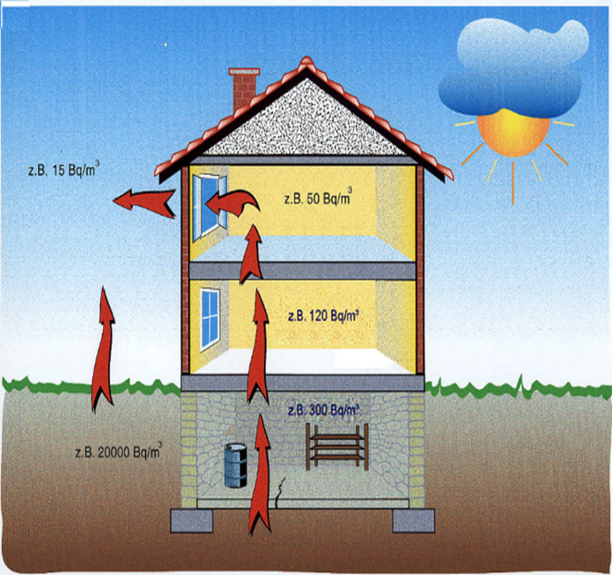
Where to measure
Aim of the survey – population exposure to radon
Representative of the occupancy of the home – in inhabited rooms only (like a bedroom and main living room)
2 detectors per house/flat is recommended
Decision regarding measurement locations in multi-story buildings and basements
Source: BfS Germany
Notes:
Where to measure depends on the purpose of measurement. This module focuses on the requirements for a representative indoor radon survey in domestic dwellings. A separate protocol will be required for buildings with high occupancy factors such as hospitals or kindergartens, and workplaces due to differences in building structure, occupancy and heating, ventilation and air conditioning.
Measurement should be representative of the exposure of the occupants of the home
Measurements should be made in occupied rooms only (as in bedrooms and main living room).
At least two detectors per home is recommended to provide a measurement that reflects night time and day time occupation and to reduce the impact of detector losses.
For multi-story buildings (apartment buildings) a decision is required on whether upper stories will be measured. Where the aim of the survey is to estimate the population exposure, then it is appropriate to measure upper floor apartments even though it is likely that the concentrations there will be relatively low. Similarly, basement rooms should be measured if they are occupied as a living room or bedroom, but should not be otherwise measured as they will likely provide higher values than those to which the population is commonly exposed.

Slide 11
Detector Placement
Radon gas distributes quite homogenously in a room
Detector position should reflect typical occupation (about 1-2 m above ground), away from ventilation inlets/outlets, not enclosed in cupboard or drawer, ideally not close to the wall.
Out of reach of children and pets
As advised by supplier – away from direct heat, sunlight, moisture, etc.
Standard protocol for the representative survey
Notes:
Radon gas distributes quite homogenously in a room so the exact position in the room is not defined for all detectors. However, the positioning of detectors should be included in the standard protocol for the representative indoor radon survey. In this way, any possible variability due to placement will be minimised across the survey and comparability across different measurements services operating in the country now and into the future will be improved.
Detector position should aim to have the detector exposed to the same body of air that the occupants will typically experience (roughly between 1 and 2 m above ground), away from ventilation inlets/outlets, not enclosed in cupboard or drawer
The detector may need to stay in position for 3 to 12 months, so a location should be chosen that will ensure it is not regularly disturbed or accessible to children or pets
Depending on the detector, the supplier may have additional requirements such as keeping the detector away from direct heat, sunlight, moisture, etc.
When deploying the detectors, the householder should be given written instructions on the placement of the detector. Where two detectors are being placed, each should be marked to identify the measurement rooms.

Slide 12
Detector handling
Handling
Manufacturers instructions
Batch storage and quality control
Packaging
Issue and return
Unwanted exposure in home
Unwanted exposure in postal service
Instructions to householder
Written, clear instructions with photographs or diagrams
Detector placement
Information on survey purpose
Questionnaire with pre-paid return envelope
Contact phone number/email for queries
Return of detectors
Support the return of detectors to minimise detector losses
Issue pre-paid return packaging separately at end of survey
Third party is used to collect the deployed detectors
Standard protocol for the representative survey
Notes:
The standard protocol for the representative survey should take account of the handling, packaging and storage of detectors.
This protocol should apply to all radon measurement services and be established by the national authority as the standard approved method.
The manufacturer of the detectors should advise on correct handling and packaging procedures to minimise loss of measurement quality.
It is likely, that there will be a large number of detectors deployed. Logistics may require that batches are stored prior to deployment. Storage conditions should be defined. Protocols for quality control on each batch should be established.
If the survey is being undertaken by post, special packaging may be required to (a) protect the detector and (b) minimise radon exposure prior to and following placement. Special packaging may be issued to each household at the end of the survey period.
For passive detectors, if the postal service is slow, it may be necessary to undertake a small study to quantify any radon exposure of the detectors while in the postal buildings.
Where householders are responsible for receipt (post), placement and return of detectors, detailed but simple instructions must be provided.
These instructions will emphasise the points above regarding the rooms in which the detector is to be placed, the placement location in the rooms, labelling of detectors for each room, packaging and return arrangements. The instructions will ideally be supported by photographs or diagrams. An information package, questionnaire with pre-paid return envelope, and contact phone number/email should be provided.

Slide 13
Quality Assurance
Managing for quality measurements
IAEA BSS General Safety Requirements (GSR) Part 3: Para 1.12: The term ‘management system’ reflects and includes the concept of ‘quality control’ (controlling the quality of products) and its evolution through ‘quality assurance’ (the system for ensuring the quality of products) and ‘quality management system’ (the system for managing quality)
Competence and quality assurance
IAEA Specific Safety Guide (SSG-32) Para 3.33: All organizations that make radon measurements should be required to demonstrate their competence to measure radon concentrations accurately and should participate regularly in inter-comparison exercises
WHO 2009: Quality assurance and quality control measures are strongly recommended to assure the reliability of radon measurements
Technical Standards for specific techniques
ISO 16641: Measurement of radioactivity in the environment — Air — Radon 220: Integrated measurement methods for the determination of the average activity concentration using passive solid-state nuclear track detectors (2014)
Notes:
Principle 3 of the Fundamental Safety Principles, upon which the Basic Safety Standards (BSS) is based, calls for “Effective leadership and management for safety” to be established and sustained in organizations concerned with, and facilities and activities that give rise to, radiation risks.
BSS Part 3 Para 1.12 provides further insight into what is expected where it states that management for safety includes “quality control” and “quality assurance”.
In addition to the choice of an appropriate radon measurement technique, a comprehensive quality assurance (QA) programme has to be set up in order to obtain radon concentration measurements of good quality, which can be trusted as being truly representative of public exposure, and which can be confidently compared with measurements made in the future.

Slide 14
Quality Assurance Programme
QA (Quality Assurance)
The set of planned and systematic actions put in place at specified stages of the radon measurement process to ensure confidence and accuracy of the measurement results (Calibrations, inter-comparison exercises, etc.)
QC (Quality Control)
The quality checks carried out within the radon measurement laboratory as part of the overall quality assurance system (duplicate measurements, background checks, etc.).
To minimise issues regarding standardisation of data, where practicable, it is recommended to use one type of detector, one laboratory or measurement service provider for the entire survey.
Notes:
Quality Assurance (QA) is the function of a management system that provides confidence that specified requirements will be fulfilled. It is a set of documented and systematic actions that should be part of the standard procedure for carrying out radon measurements.
Quality Control (QC) is a specific set of checks that are carried out as part of the laboratory procedure and contribute to the quality assurance programme.
A comprehensive QA programme should include:
the identification and control of possible sources of errors affecting measurement trueness and precision, including detector background and ageing/fading effects;
calibrations, including tests of response linearity;
quality control procedures, including duplicate measurements and participation in inter-laboratory comparison exercises.

Slide 15
Quality Assurance Programme
The QA programme should extend from the beginning to the end of the measurement process – from detector acquisition, through placement, measurement and reporting, including customer relationship management.
This should be required of measurement service providers in order that they are approved by the national authority to participate in the survey or to provide services to the public.
Detector Purchase
Detector Handling
Data
Reporting
Laboratory Measurement
Detector Placement
Notes:
QA/QC is the responsibility of the measurement service provider.
To minimise issues regarding standardisation of data, it is recommended to use one type of detector, one laboratory or measurement service provider for the entire survey, but this may not be practical to achieve. Where each service provider is required to adhere to a standard quality assurance programme, the problems of comparability will be reduced.
The application of a QA programme should be part of the standard protocol required of an approved service provider
The QA programme should address sources of error at all stages in the process, not just in the laboratory elements. The representative indoor radon survey is a significant public relations project and quality standards should address customer relationship management.

Slide 16
Summary of Learning Points (1)
The detector type selected for use in the representative radon survey will be influenced by consideration of costs and survey logistics as much as technical considerations
Radon concentrations in homes fluctuate daily, seasonally and over the year
Measurement protocol must take account of these fluctuations
If applied, seasonal correction factors should be determined under local conditions
To derive the annual average indoor radon concentration a measurement of 1 year duration is recommended
A measurement duration of 2 months, coinciding with the heating (winter) season, is the minimum recommended

Slide 17
Summary of Learning Points (2)
A minimum of 2 detectors per home is recommended
Placement in the home should represent the body of air to which the occupants are exposed
Consideration should be given to the possibility of radon exposure of detectors during transport and storage
A quality assurance programme should be part of the standard protocol for carrying out the representative radon survey and for approved radon measurement services

Slide 18
Further Reading
IAEA (2015). Protection of the Public against Exposure Indoors due to Radon and Other Natural Sources of Radiation: Specific Safety Guide No. SSG-32.
International Organization for Standardization (ISO) (2014) ISO 16641: Measurement of radioactivity in the environment —Air — Radon 220: Integrated measurement methods for the determination of the average activity concentration using passive solid-state nuclear track detectors.
ISO 11665, Measurement of radioactivity in the environment —Air — Radon-222.
ISO/International Electrotechnical Commission (IEC) 17025: General requirements for the competence of testing and calibration laboratories (2005).
ISO 9001: Quality Management Systems.
IEC 61577: Radiation protection instrumentation - radon and radon decay product measuring instruments.
World Health Organization (WHO) (2009). Handbook on Radon: A Public Health Perspective, Geneva.

Slide 19
July 2018

